Slide 1
Kutztown Rotary Club Assembly
July 10, 2024

Slide 2
New Board
Board
Marie DeFilipps - President
Rose Galeano-Phillips - President Elect
Kurt Rohrbach - Past President
Secretary - Melissa Kirk
Treasurer - Holly Deifenderfer
Director - Jim Springer
Director - Chris Volk
Director- Erin Bailey

Slide 3
Past Year 2023-2024 Volunteer and Service Projects
Volunteered at Folk Festival Das Awkscht Fest Kutztown Day
Potato Project Flag Day Concert Dinner on Main
Toiletries for KU Student Pantry Farmers Night Student of the Month
TOK Holiday Meals for Friend Inc Community Meals
And More

Slide 4
New Service Projects
Grant combination with Bethlehem Morning Star for School in Kenya-budgeted
Veterans Breakfast in November with Optimists Club (?)
Possible HANWASH Water Project Donation

Slide 5
Club Goals
3 of 21 are already achieved thanks
Updated Strategic Plan
Updated Bylaws
Use of official promo materials

Slide 6
Club Committees
Foundation
Ralph Capristo
Mike Collins
Holly
Nancy
Florita
Melissa
Tom
Joni
Kurt
Taste of Kutztown
Ralph
Mike
Florita
Meredith
Willem
Mana
Melissa
Tom
Ellen
Chris Peterson
Kurt
Amy
Jim
Grants
Melissa
Marie
Tom
Bob
Amy
Youth
Marie
Erin
Rose
Doug
Bob
100 Anniversary
Florita
Mike
Rose
Bob
Melissa
Tom
Kurt
Amy
Jim
Janet
Farmers Night
Bob
Kyleigh
Erin
Mike
Florita
Marie
Nancy
Holly
Willem
Mana
Membership
Chris Volk
Jim Springer
Public Image
Amy
Melissa
Mana

Slide 7
Committee Reports
What’s happening in your committee?
Updates and conversation…….

Slide 8
Survey Fun
Take a little survey so we can learn more about you………
About Me Survey Questions
Name_______________
What are your hobbies?___________________________________________
Do you collect anything?___________________________________________
What’s on your bucket list?__________________________________________
What activities did you do in High School?______________________________
What countries have you been to?____________________________________
Prize Winners……….

Slide 9
Training Opportunities
my.rotary.org - register/sign in Learning Center - self directed
rotarydistrict7430.org more happenings
September 14th in person Rotary Action Plan at MONTCO
8:00-3:00 continental breakfast, scrumptious lunch, $55.00 we pay
Education incentives for those that participate

Slide 10
Upcoming Social Event
July 24th
Gassers Mini Golf: TIME?
Package: HD, drink , golf : $11.50, HD, drink, IC, golf $15.00, GOLF ONLY $7.00
Liberty at Dryville?????
Thoughts………………..

Slide 11
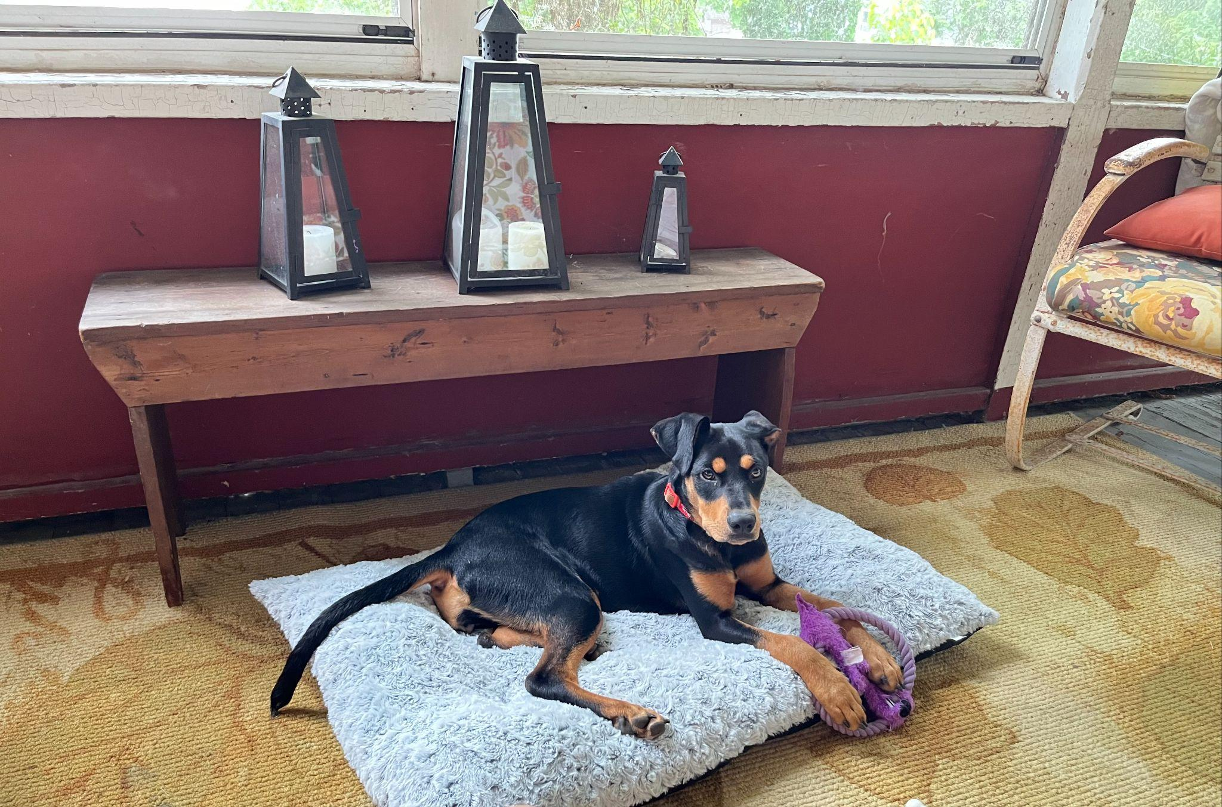
Wrap Up
Questions
Comments
Suggestions
Leave Surveys on the Table or give to me.
Have a Wonderful Week!!!

